Slide 1
Cloud-Based College Event Registration System
Capstone Project – Google Cloud Digital Leader
By:
Debankita Biswas, KU Id.: KU2507U0798
Dhrumi Shah, KU Id.: KU2507U0140

Slide 2
Capstone Project – Google Cloud Digital Leader
Overview
A web-based application for students to register for college events like Tech Fest, Cultural Events, and Workshops.
Provides a simple and user-friendly registration form.
Stores data securely in the cloud.
Objective
To build a cloud-native, scalable web application using Google Cloud Platform.
To demonstrate serverless architecture and modern cloud concepts.
To create a working local prototype and deploy it on cloud.
By:
Debankita Biswas, KU Id.: KU2507U0798
Dhrumi Shah, KU Id.: KU2507U0140
Cloud-Based College Event Registration System

Slide 3
Key Features of the Form
Student registration form with:
Data stored in cloud database
Success message after registration
Publicly accessible via web URL (no login required)
Full Name
Event Name

Slide 4
Asynchronous Processing: Cloud Pub/Sub – To loosely couple the system with future services like automated email notifications.
Google Cloud services used and justification
Frontend Storage: Google Cloud Storage – To host the static HTML/CSS files for public access.
Architecture Diagram
1. User
User clicks on the interface, enters data, or requests an action.
2. Web App
Web App Request: -Web App processes the user's input and initiates a request.
3. Backend Service
Backend Service handles the logic, business rules, and data access.
4. Cloud Database
Cloud Database stores, updates or retrieves the required data.
Flow:
Possible Services
Hosting: Google Cloud Run (Serverless) – To host the Flask backend container without managing servers.
Database: Cloud SQL (MySQL) – A managed relational database service to store registration data securely.

Slide 5
Asynchronous Processing: Cloud Pub/Sub – To loosely couple the system with future services like automated email notifications.
Google Cloud services used and justification
Frontend Storage: Google Cloud Storage – To host the static HTML/CSS files for public access.
Architecture Diagram
Components
Frontend: HTML5, CSS3 (with CSS-based tooltips), and JavaScript (Fetch API) for an interactive user experience.
Backend: Python-based Flask server serving as a RESTful API.
Database: MySQL relational database for persistent storage of participant details.
Explanation Points
User fills form
Request sent to backend
Data stored in cloud database
Response (success message) sent back
Possible Services
Hosting: Google Cloud Run (Serverless) – To host the Flask backend container without managing servers.
Database: Cloud SQL (MySQL) – A managed relational database service to store registration data securely.

Slide 6
Google Cloud services used and justification
Hosting: Google Cloud Run (Serverless) – To host the Flask backend container without managing servers.
Possible Services
Frontend Storage: Google Cloud Storage – To host the static HTML/CSS files for public access.
Database: Cloud SQL (MySQL) – A managed relational database service to store registration data securely.
Asynchronous Processing: Cloud Pub/Sub – To loosely couple the system with future services like automated email notifications.
Serverless → No server management required
Scalable → Handles multiple users automatically
Reliable → High availability and fault tolerance
Easy integration with future services
Justification

Slide 7
Key learnings and challenges
All the used Libraries
Flask:
Flask-CORS:
pymysql:
qrcode:
io (built-in): Handles in-memory file operations (like QR images)
base64 (built-in): Encodes QR images for sending via API or embedding in HTML
os (built-in): Used for file handling and system operations
FPDF: Generates PDF files (e.g., registration confirmation/ticket)
Used to build the backend web application (API handling)
Handles HTTP requests (GET/POST)
Enables communication between frontend and backend
Prevents cross-origin request issues
Connects Python application to MySQL database
Used to store and retrieve registration data
Generates QR codes for event registration
Can be used for entry validation or ticketing
Key Learnings
Challenges Faced
Learning cloud services configuration
Connecting frontend with backend
Deployment issues
Managing data storage
Understanding of cloud computing concepts
Working with serverless architecture
Deploying applications on Google Cloud
Database integration with web apps

Slide 8
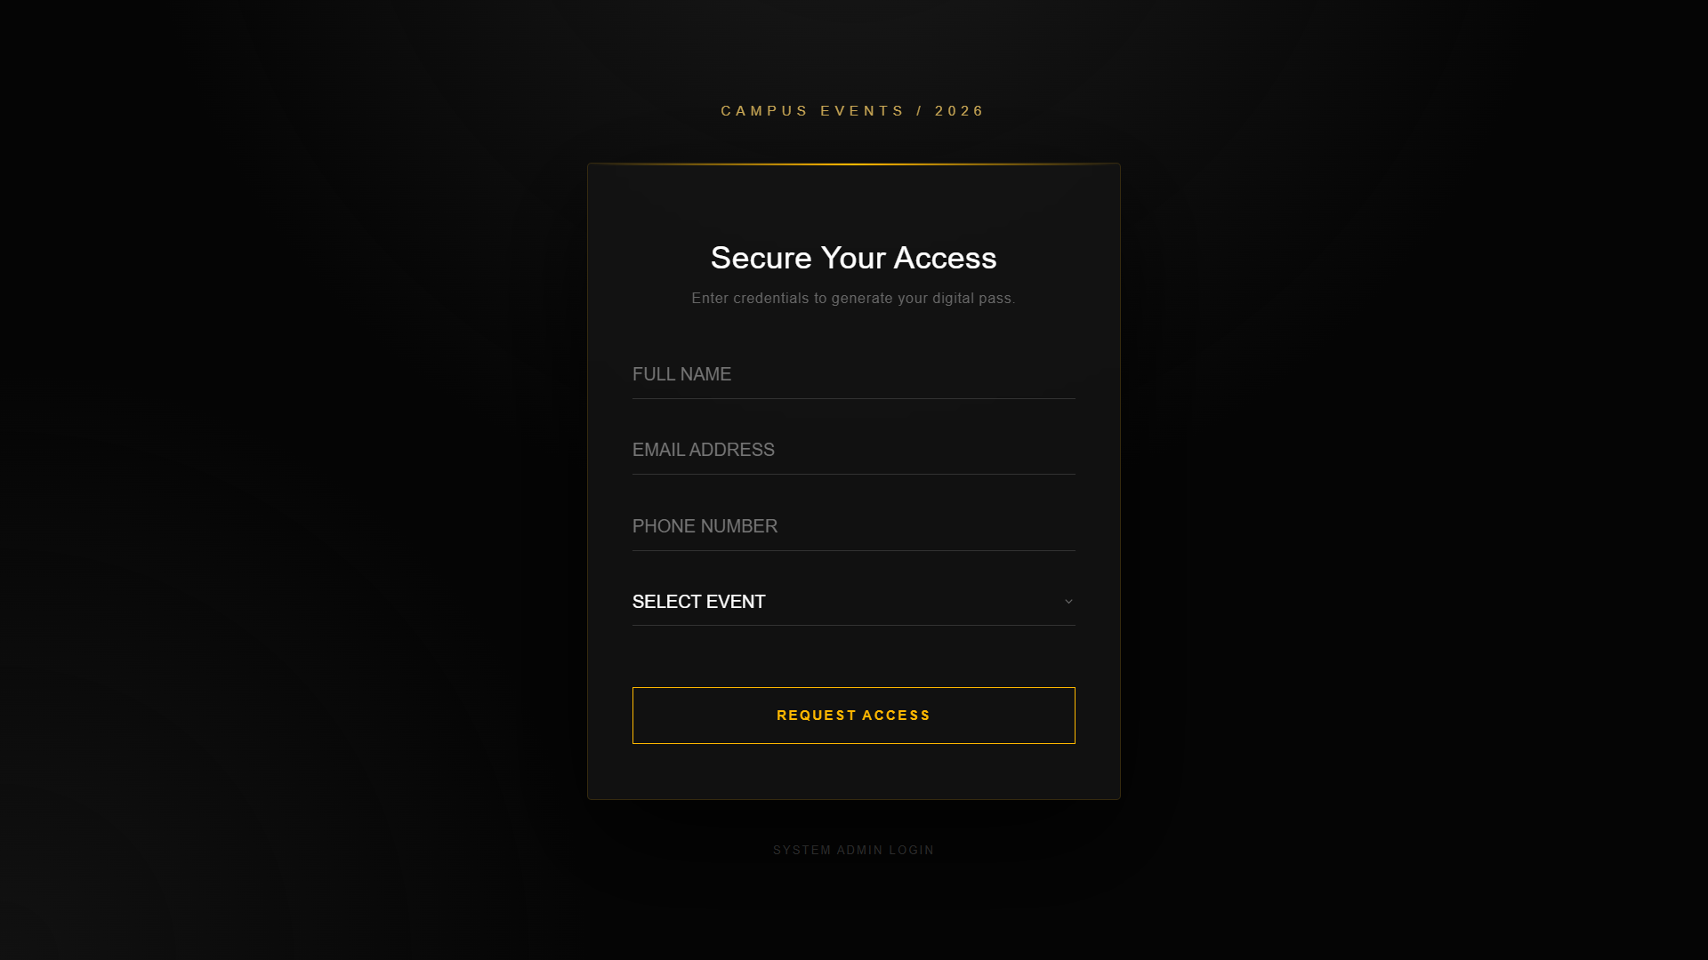
Key learnings and challenges
Key Learnings
Challenges Faced
Understanding of cloud computing concepts
Working with serverless architecture
Deploying applications on Google Cloud
Database integration with web apps
Learning cloud services configuration
Connecting frontend with backend
Deployment issues
Managing data storage

Slide 9
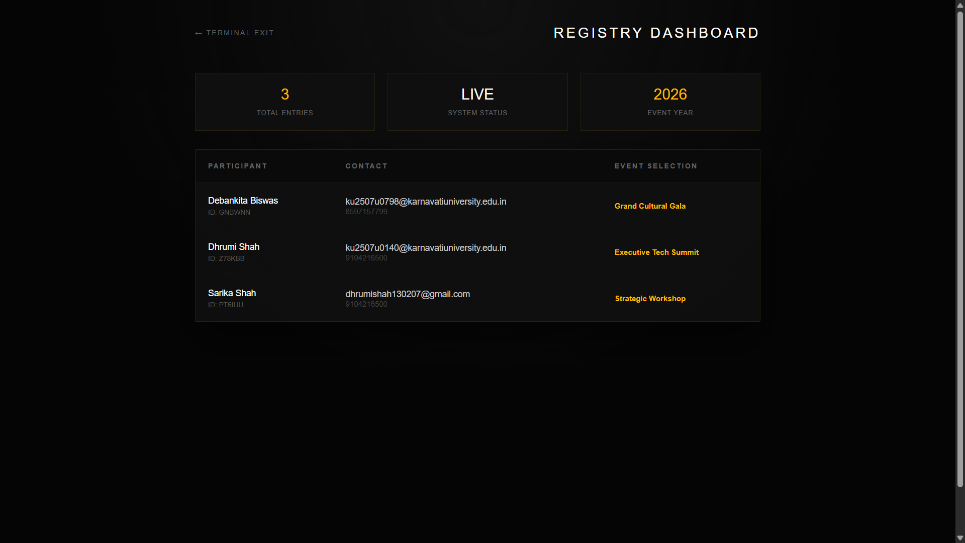
Admin Page
Main Page

Slide 10
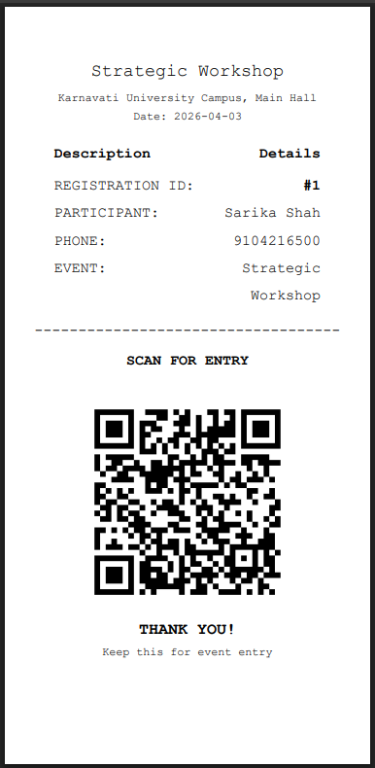
Admin Page

Slide 11
Receipt

Slide 12
Key learnings and challenges
Thank You
Key Learnings
Challenges Faced
Learning cloud services configuration
Connecting frontend with backend
Deployment issues
Managing data storage
Understanding of cloud computing concepts
Working with serverless architecture
Deploying applications on Google Cloud
Database integration with web apps

